Slide 1
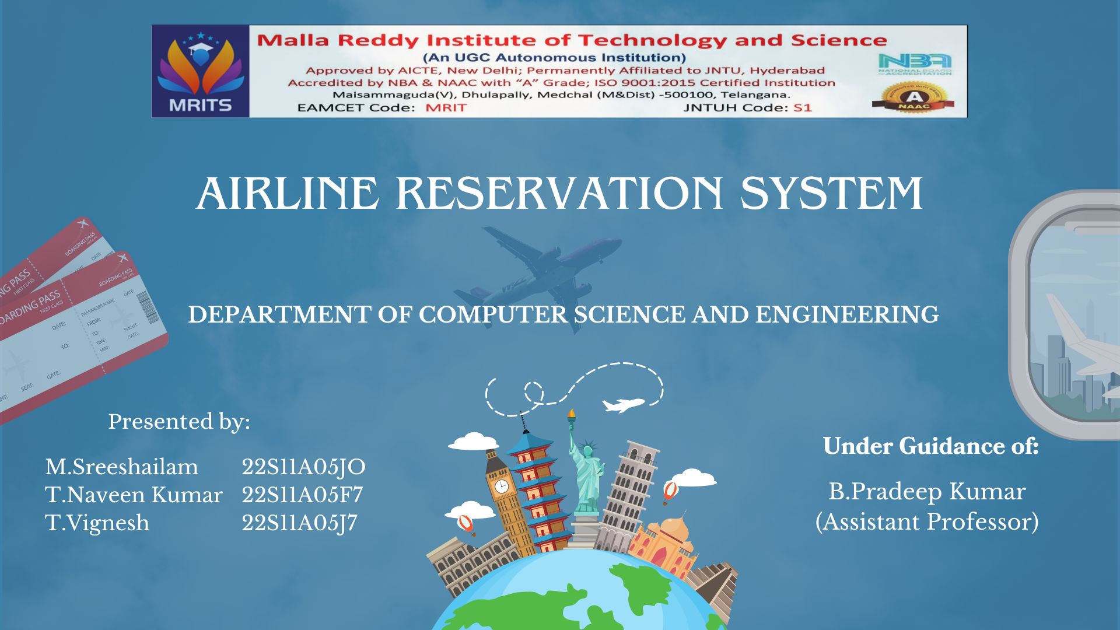

Slide 2





AIRLINE
RESERVATION
SYSTEM

Slide 3


  Abstract
  Introduction
  Booking Process
  Existing system
  Hardware &Software Requirements
  Advantages
  Applications
  Result Analysis
  Future Scope
  Conclusion
CONTENT

Slide 4
ABSTRACT
An airline reservation system is an advanced software platform designed to streamline the process of booking flights and managing reservations. It allows passengers to search for flights, compare prices, select seats, and purchase tickets online. The system integrates real-time data on flight schedules, availability, and fares, ensuring accurate and efficient transactions. Key features include passenger information management, e-ticket issuance, and support for cancellations and itinerary changes. By automating these tasks, the airline reservation system enhances operational efficiency, reduces manual errors, and provides a convenient, user-friendly experience for travelers, ultimately improving overall customer satisfaction and travel management.

Slide 5
An airline reservation system is a software application used by airlines to manage and facilitate the booking process for passengers.
It allows customers to search for flights, select seats, make payments, and receive booking confirmations.
The system also enables airlines to manage inventory, schedule flights, and track passenger data efficiently.
INTRODUCTION

Slide 6
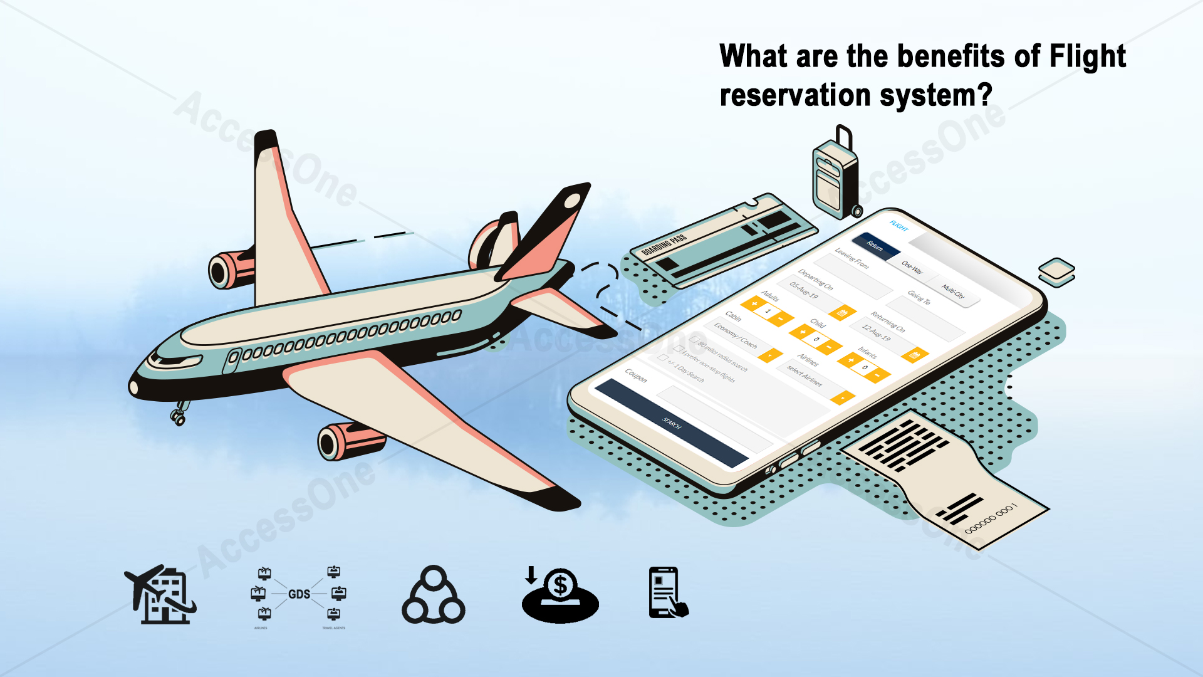
BOOKING PROCESS
Customers can search for flights based on criteria such as date, time, destination, and class.
Once a flight is selected, customers can choose seats, enter passenger details, and make payment.
The system will generate a booking confirmation with a unique reference number for the customer to use.

Slide 7
Existing System
Manual Systems: In the bygone era, airlines relied on paper records and phone calls. Passengers would contact the airline directly or visit a travel agent to inquire about flight options and availability. Reservations were then manually recorded in ledgers or on index cards, a process prone to errors and limited in scalability.
Legacy Computer Systems: The introduction of computers brought some improvement. Airlines adopted reservation software to manage flight schedules, fares, and passenger information. However, these early systems were often cumbersome and lacked the user-friendliness of modern solutions.

Slide 8
Hardware Requirements:
Server: The backbone of the system.
  Requirements: Reliable and powerful processor (e.g., Intel Xeon), sufficient RAM (minimum 16GB, recommended 32GB or more), ample storage capacity (based on data volume, consider RAID configuration for redundancy).
  Justification: Handles user requests, manages data, and ensures smooth operation.
Network: Connects users and various system components.
  Requirements: Secure and reliable network infrastructure with high bandwidth.
  Justification: Enables data transfer between users, servers, and potentially other airline systems.
Client Devices: Users will access the system through various devices.
  Requirements: Standard desktop computers, laptops, or mobile devices with internet access and compatible web browsers.
  Justification: Flexibility for users to access the system from their preferred devices.

Slide 9
Software Requirements:
Operating System (OS): Platform for running the ARS software.
  Options: Popular server operating systems like Microsoft Windows Server, Linux distributions (e.g., Ubuntu Server, Red Hat Enterprise Linux).
  Justification: Provides a stable and secure foundation for the application.
Database Management System (DBMS): Stores and manages airline data.
  Options: Industry-standard relational databases like MySQL, Oracle Database, Microsoft SQL Server.
  Justification: Efficient storage, retrieval, and manipulation of large datasets (flights, passengers, bookings).

Slide 10
Advantages:
Convenience: Passengers can search for flights, compare fares, and book tickets 24/7 from anywhere with an internet connection.
Transparency: Real-time availability information empowers passengers to find the best deals and make informed decisions.
Flexibility: Manage bookings online, including seat selection, meal preferences, and special requests.
Self-service options: Online check-in, mobile boarding passes, and e-tickets minimize queuing and streamline the travel process.

Slide 11
Applications:
Flight Search and Booking: Core functionality – search for flights based on origin, destination, date, and desired cabin class. View real-time availability and fares, and seamlessly complete ticket purchases.
Trip Management: Manage existing bookings online, including making changes to itineraries, selecting seats, and adding special requests (e.g., meals, extra legroom).
Online Check-in: Save time at the airport by checking in for flights online and obtaining mobile boarding passes.
Travel Information: Access valuable travel resources, including airport information, baggage allowances, and flight status updates.
Loyalty Programs: Manage frequent flyer accounts, track points, and redeem rewards for future travel.

Slide 12
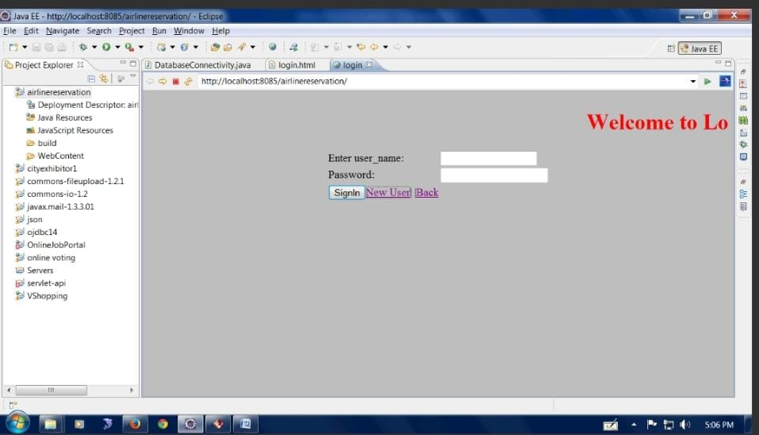
RESULT ANALYSIS:

Slide 13
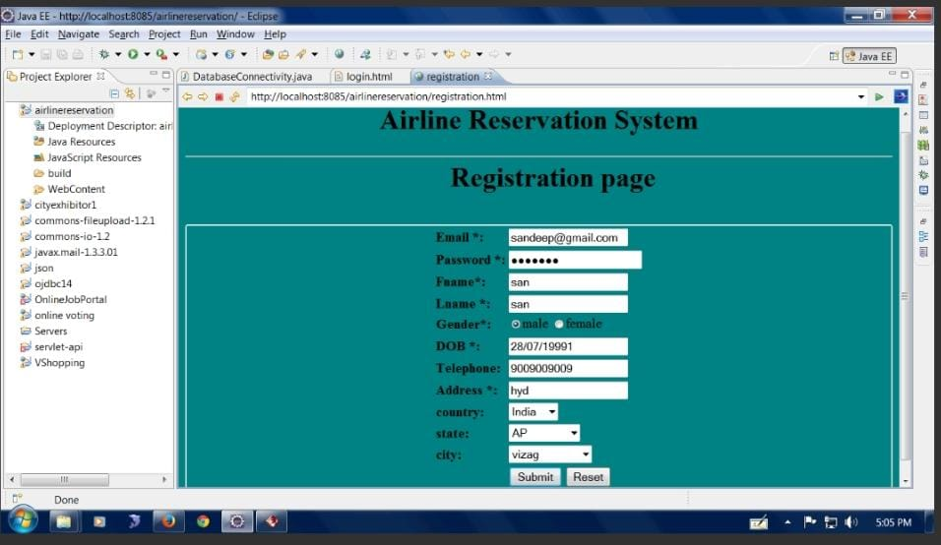

Slide 14
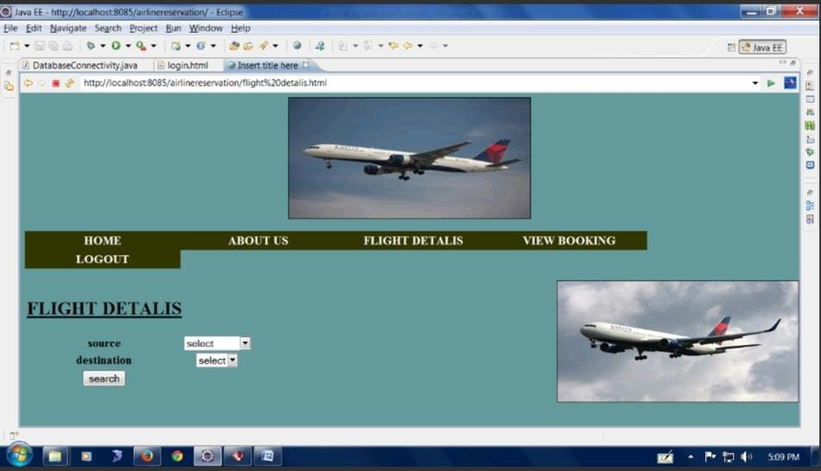

Slide 15
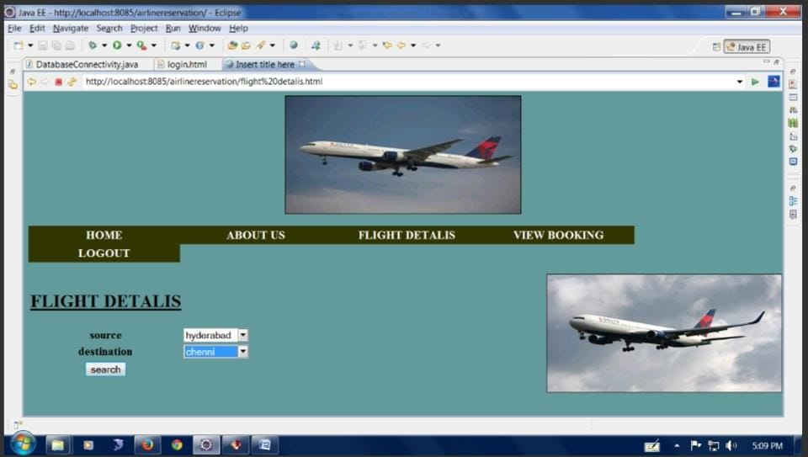

Slide 16
Future Scope:
Virtual reality technology may be integrated to offer immersive booking experiences and virtual tours of aircraft cabins.
Predictive analytics can help airlines anticipate demand, optimize pricing, and personalize offers for customers.
Seamless integration with smart devices and voice assistants may redefine how customers interact with airline reservation systems.

Slide 17

Conclusion:
Airline reservation systems play a critical role in modern air travel by streamlining booking processes and enhancing customer experiences.
Continuous innovation and adaptation to emerging technologies will shape the future of airline reservation systems.
By prioritizing reliability, security, and customer satisfaction, airlines can leverage reservation systems to stay competitive in the industry.

Slide 18

THANK YOU

